Slide 1

Artificial Intelligence (AI101B)
Even Semester Session 2024-25
Predicting House Prices With Supervised Learning
Akanksha Dwivedi(202410116100012)
Anshu Patel(202410116100034)
Project Supervisor: Mr. Apoorv jain Assistant Professor

Slide 2
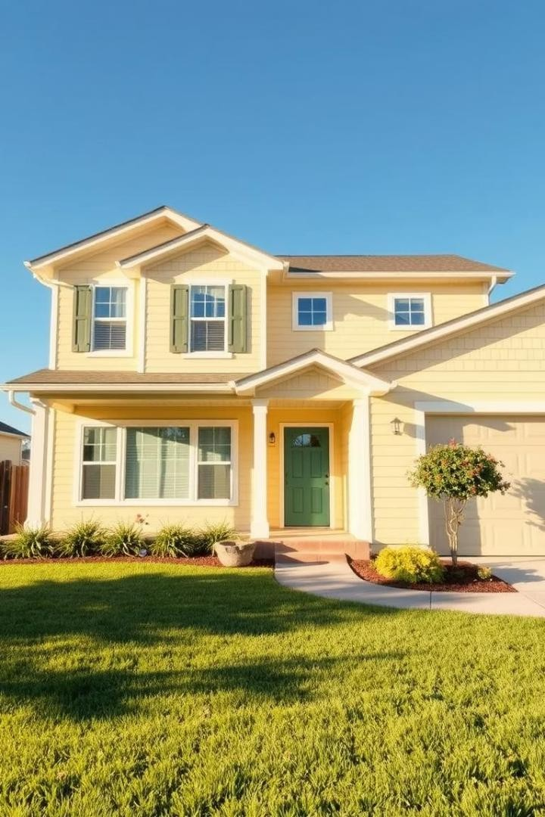
Introduction
House Price Prediction
Predicting housing prices using machine learning techniques. techniques. Leveraging popular Python libraries for accurate accurate price estimation. Provides an end-to-end solution solution for real estate professionals.
AI-driven approach to real estate valuation
Machine learning revolutionizing real estate price prediction
Advanced statistical techniques for property price modeling

Slide 3
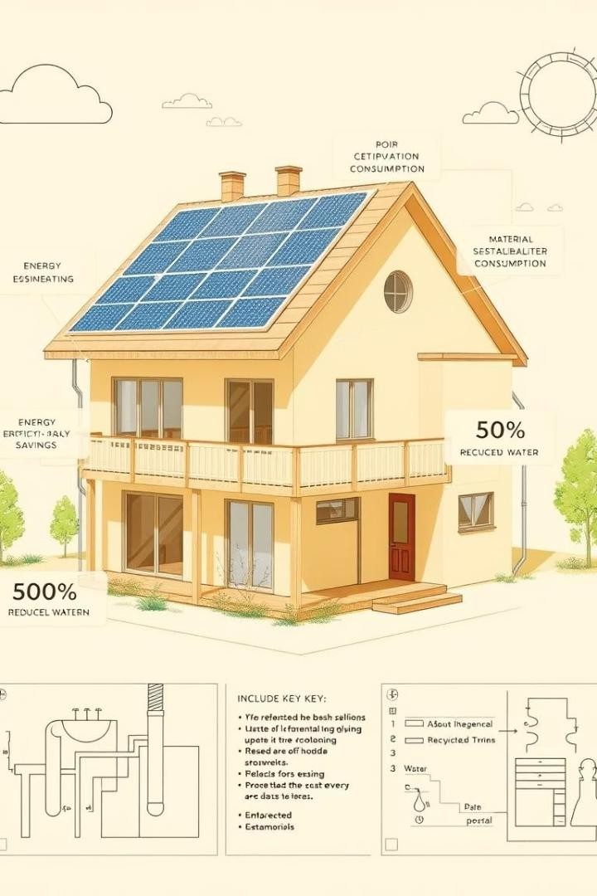
Project Goals
Accurate Predictions
Achieve precise housingprice predictions.
Feature Identification
Identify important factors influencing prices.
Perform ance Evaluation
Evaluate model performance usingkey metrics.
User Interface
Develop a user-friendly application.

Slide 4
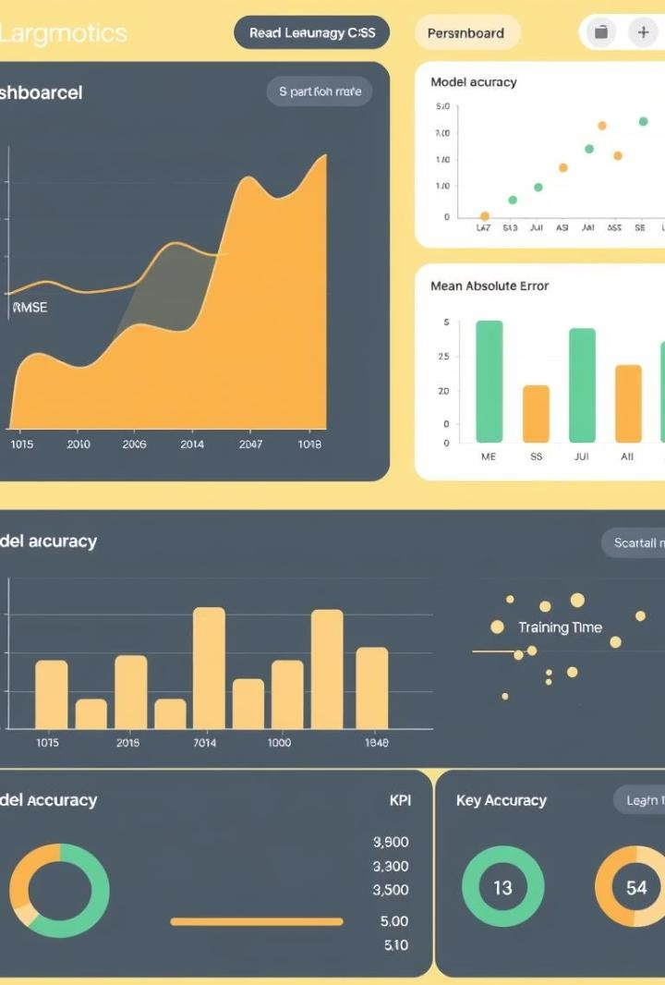
Data Collection
Data Sources
California house price
Preprocessing Steps
Feature engineering Data cleaning
Data transformation
Train/Test Split
80/20 ratio for training and testing.

Slide 5
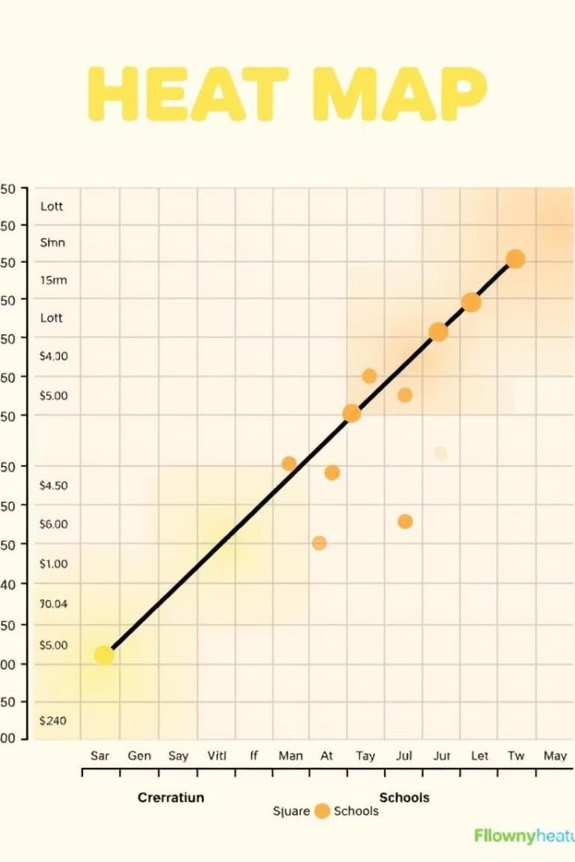
Feature Selection
C orrelation Analysis
Analyze correlation m atrix.
Importance Scores
Use XGBoost feature importance.
Select Top Features
Reduce m odel com plexity.

Slide 6
Objective of the Project
Predicting House Prices With Supervised Learning
To develop a machine learning model using supervised learning techniques for accurately predicting house prices.
To analyze and preprocess historical housing data, identifying key features that influence property values.
To provide a reliable price estimation system that assists stakeholders like buyers, sellers, and real estate agents in making data-driven decisions.

Slide 7
Data Preprocessing and Feature Engineering
Key steps:
Remove null values
Clean unnecessary data columns
Perform feature engineering
Conduct exploratory data analysis
Feature selection critical for model accuracy
Model Training and Validation
Standard data split:
80% training data
20% testing data
Understanding bias-variance tradeoff:
Model Bias: Underfit leading to poor predictions
Model Variance: Overfit leading to poor generalization

Slide 8

Conclusion
Successful Implementation
Effective price prediction model.
Future Enhancements
Add m ore features, explore deep learning.
Real-Time Data
Integ rate live data feeds.

Slide 9
THANK YOU

